Slide 1

Group 5

Slide 2
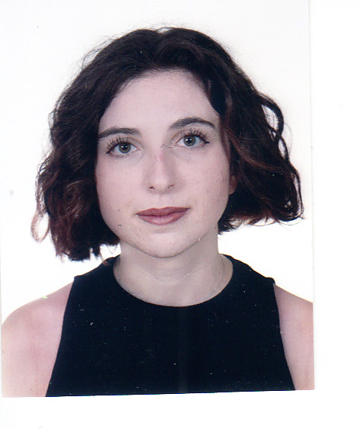
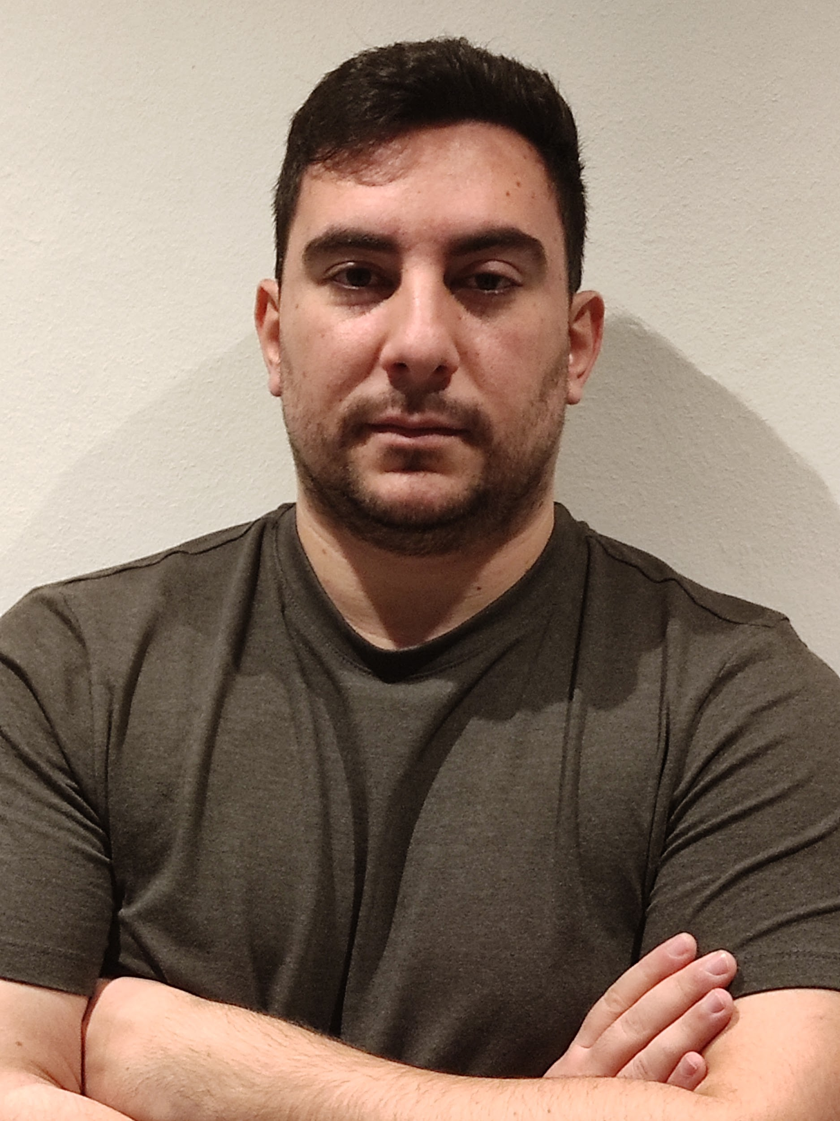
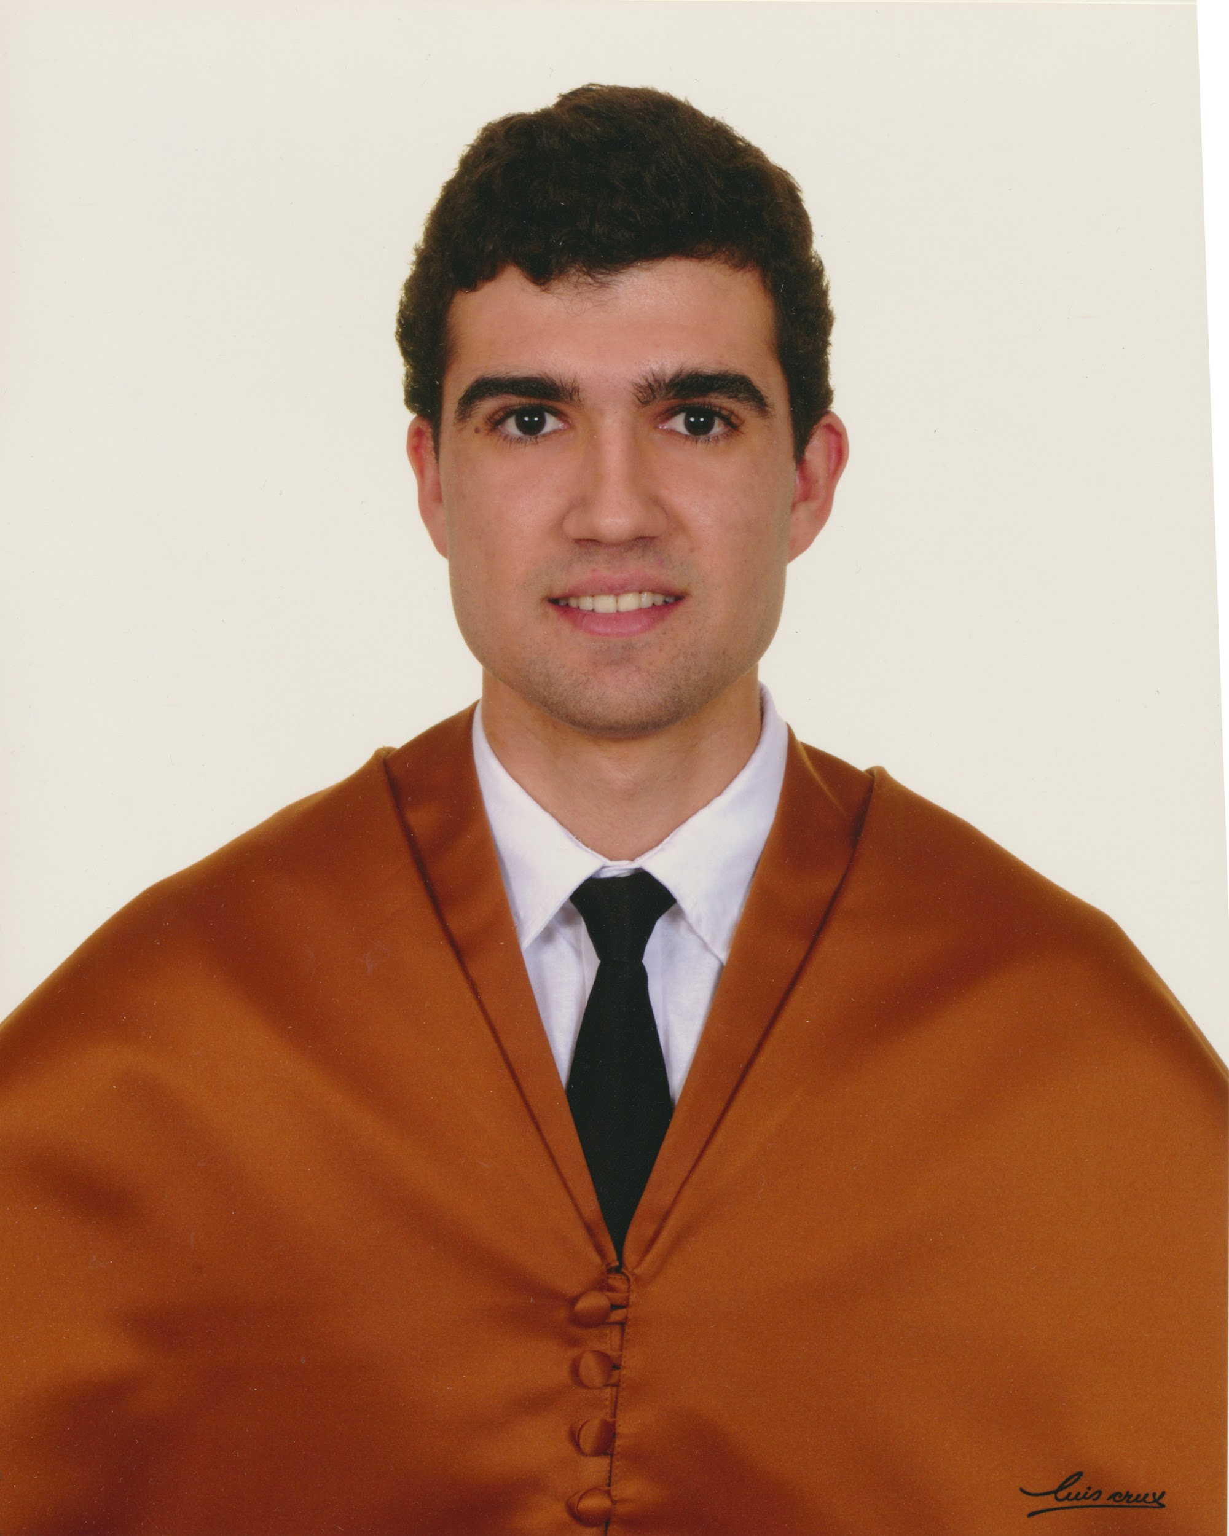
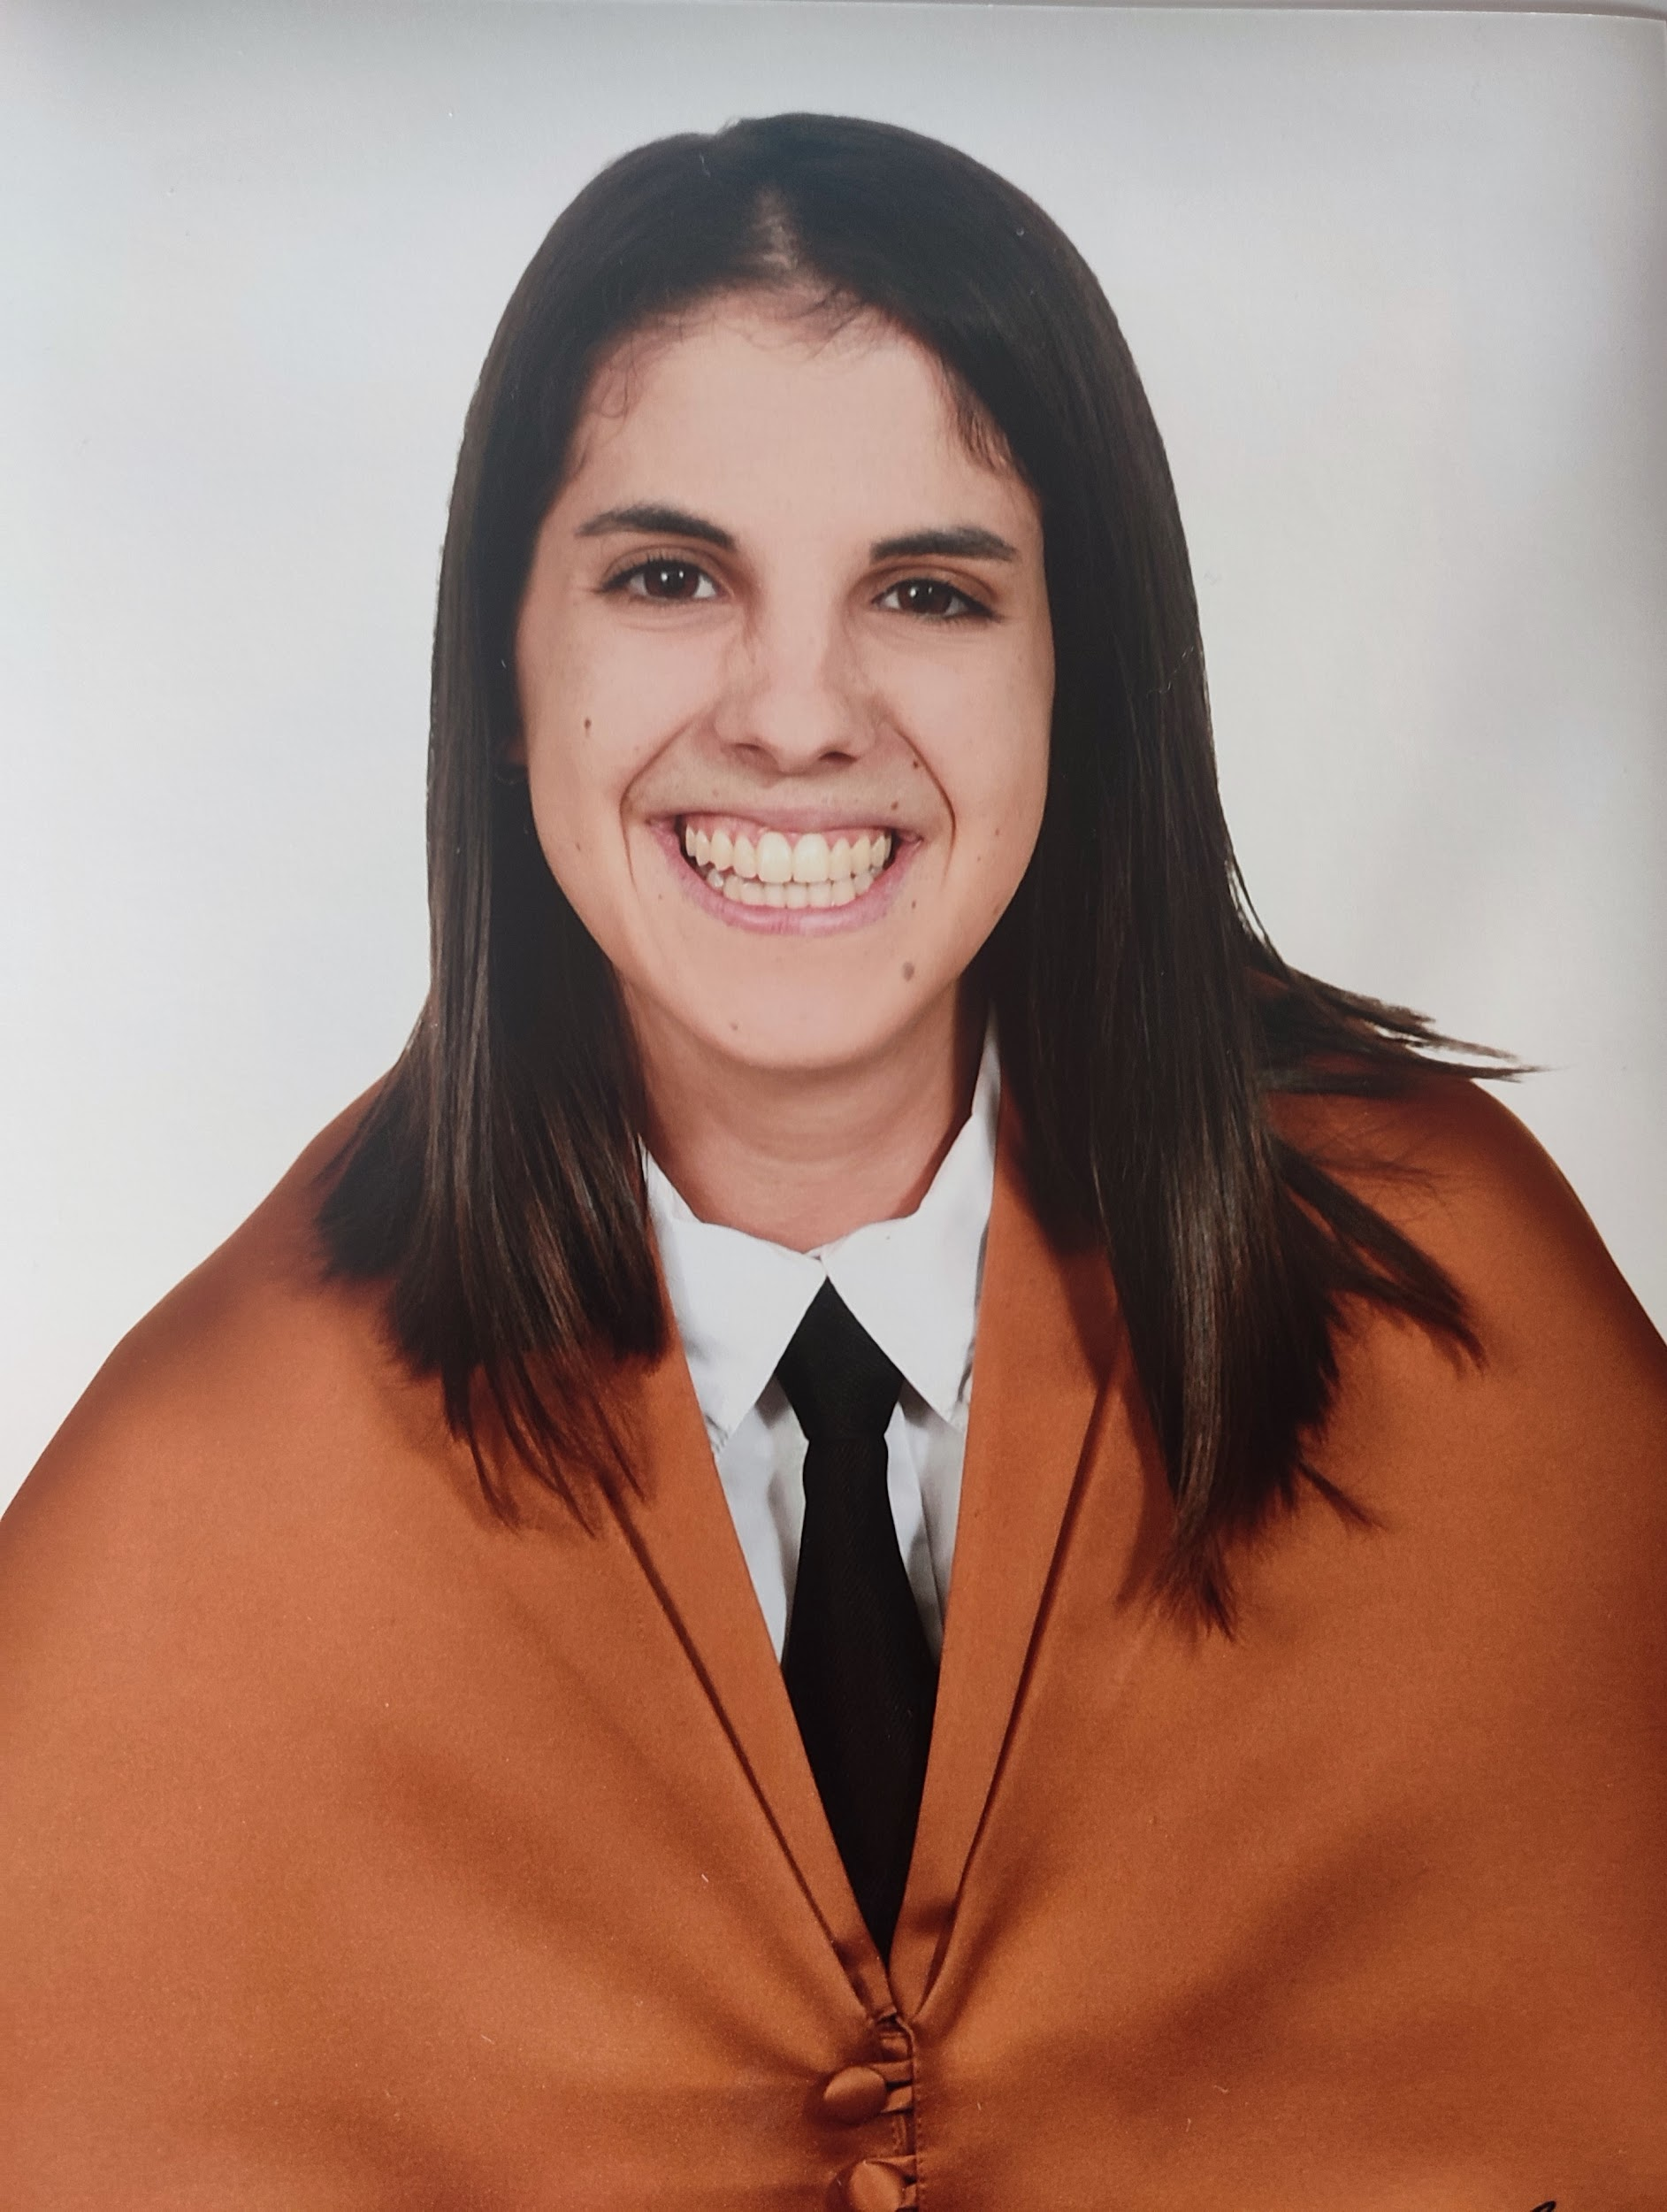
Our team
Marta González
Miguel Ángel Romalde
Pablo Periañez
Claudia Gilabert
Project Manager
Project Manager
Back End Team Lead
Front End Team Lead
Portavoz

Slide 3
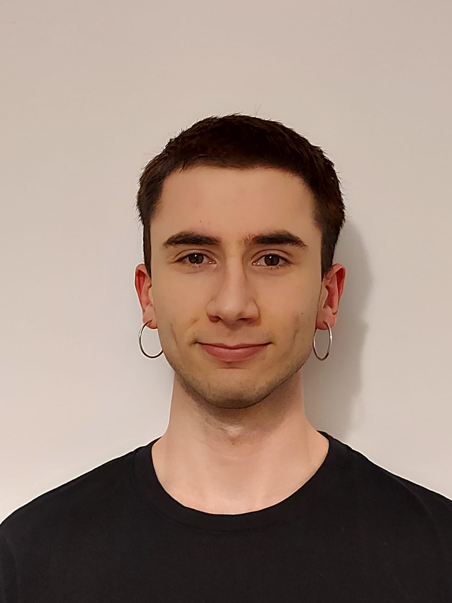
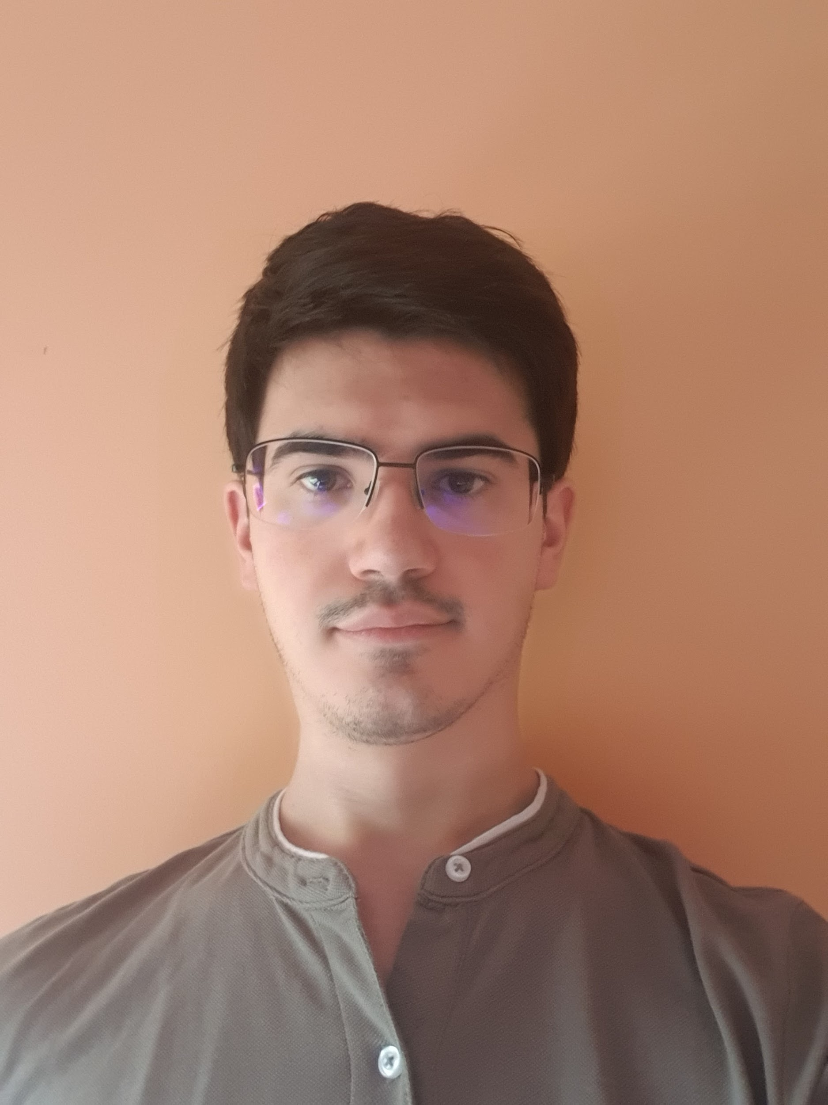
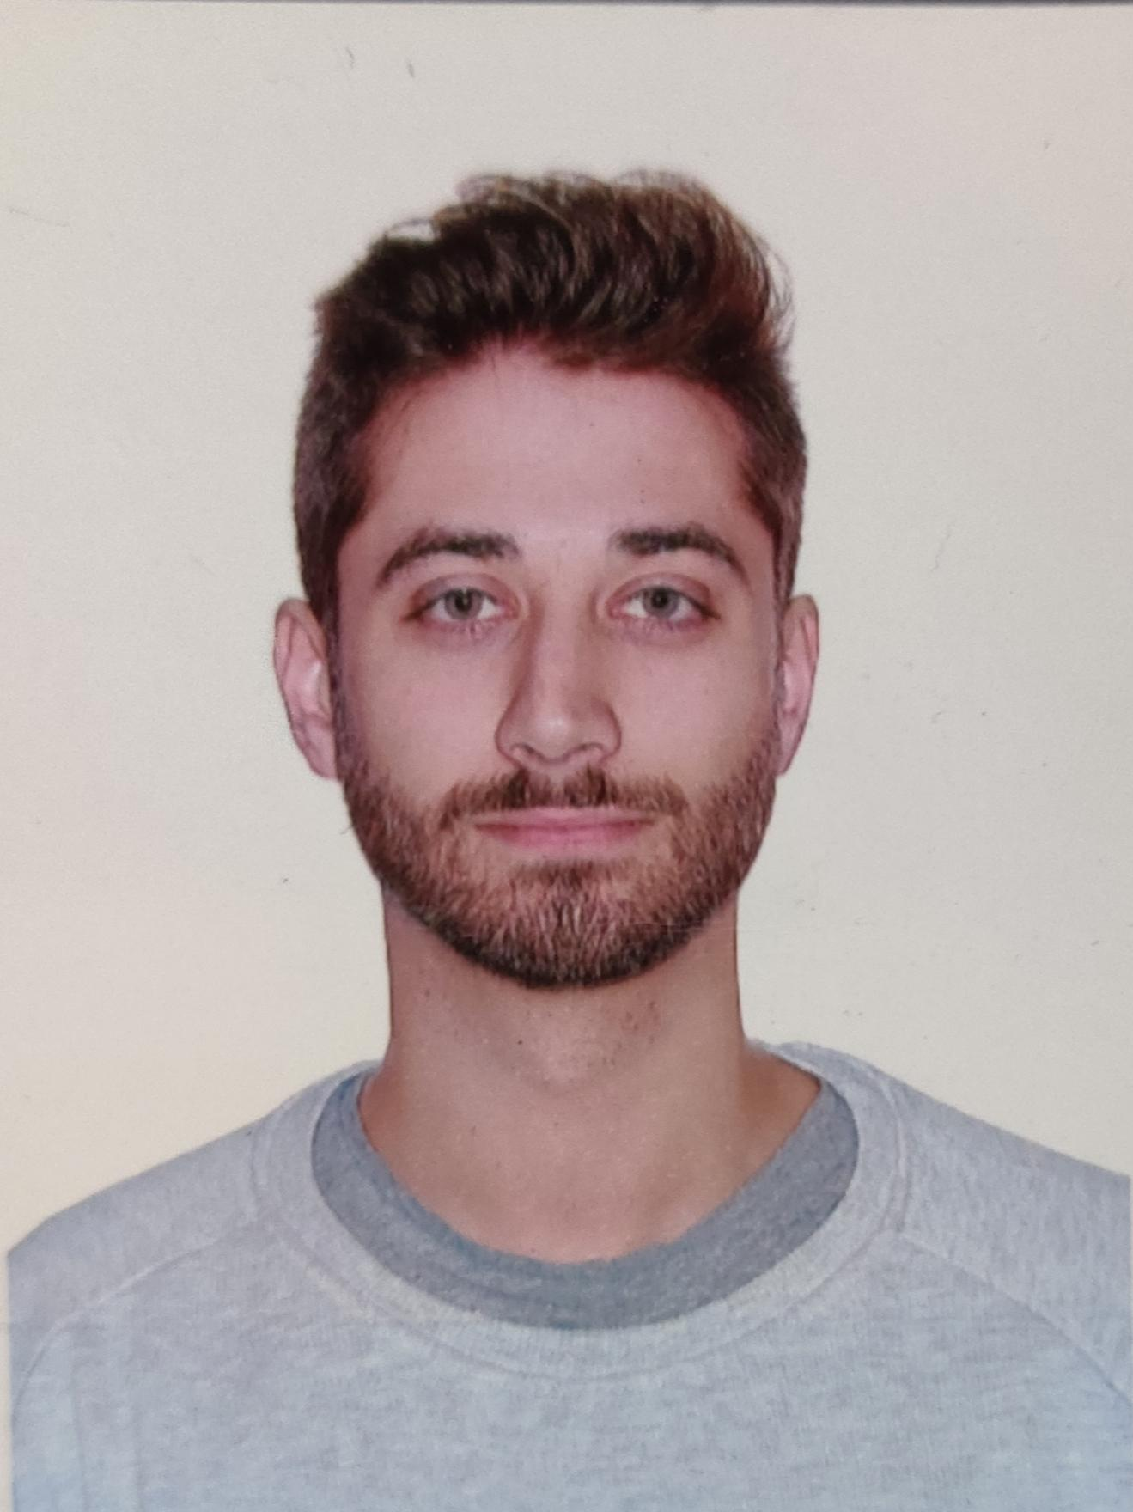
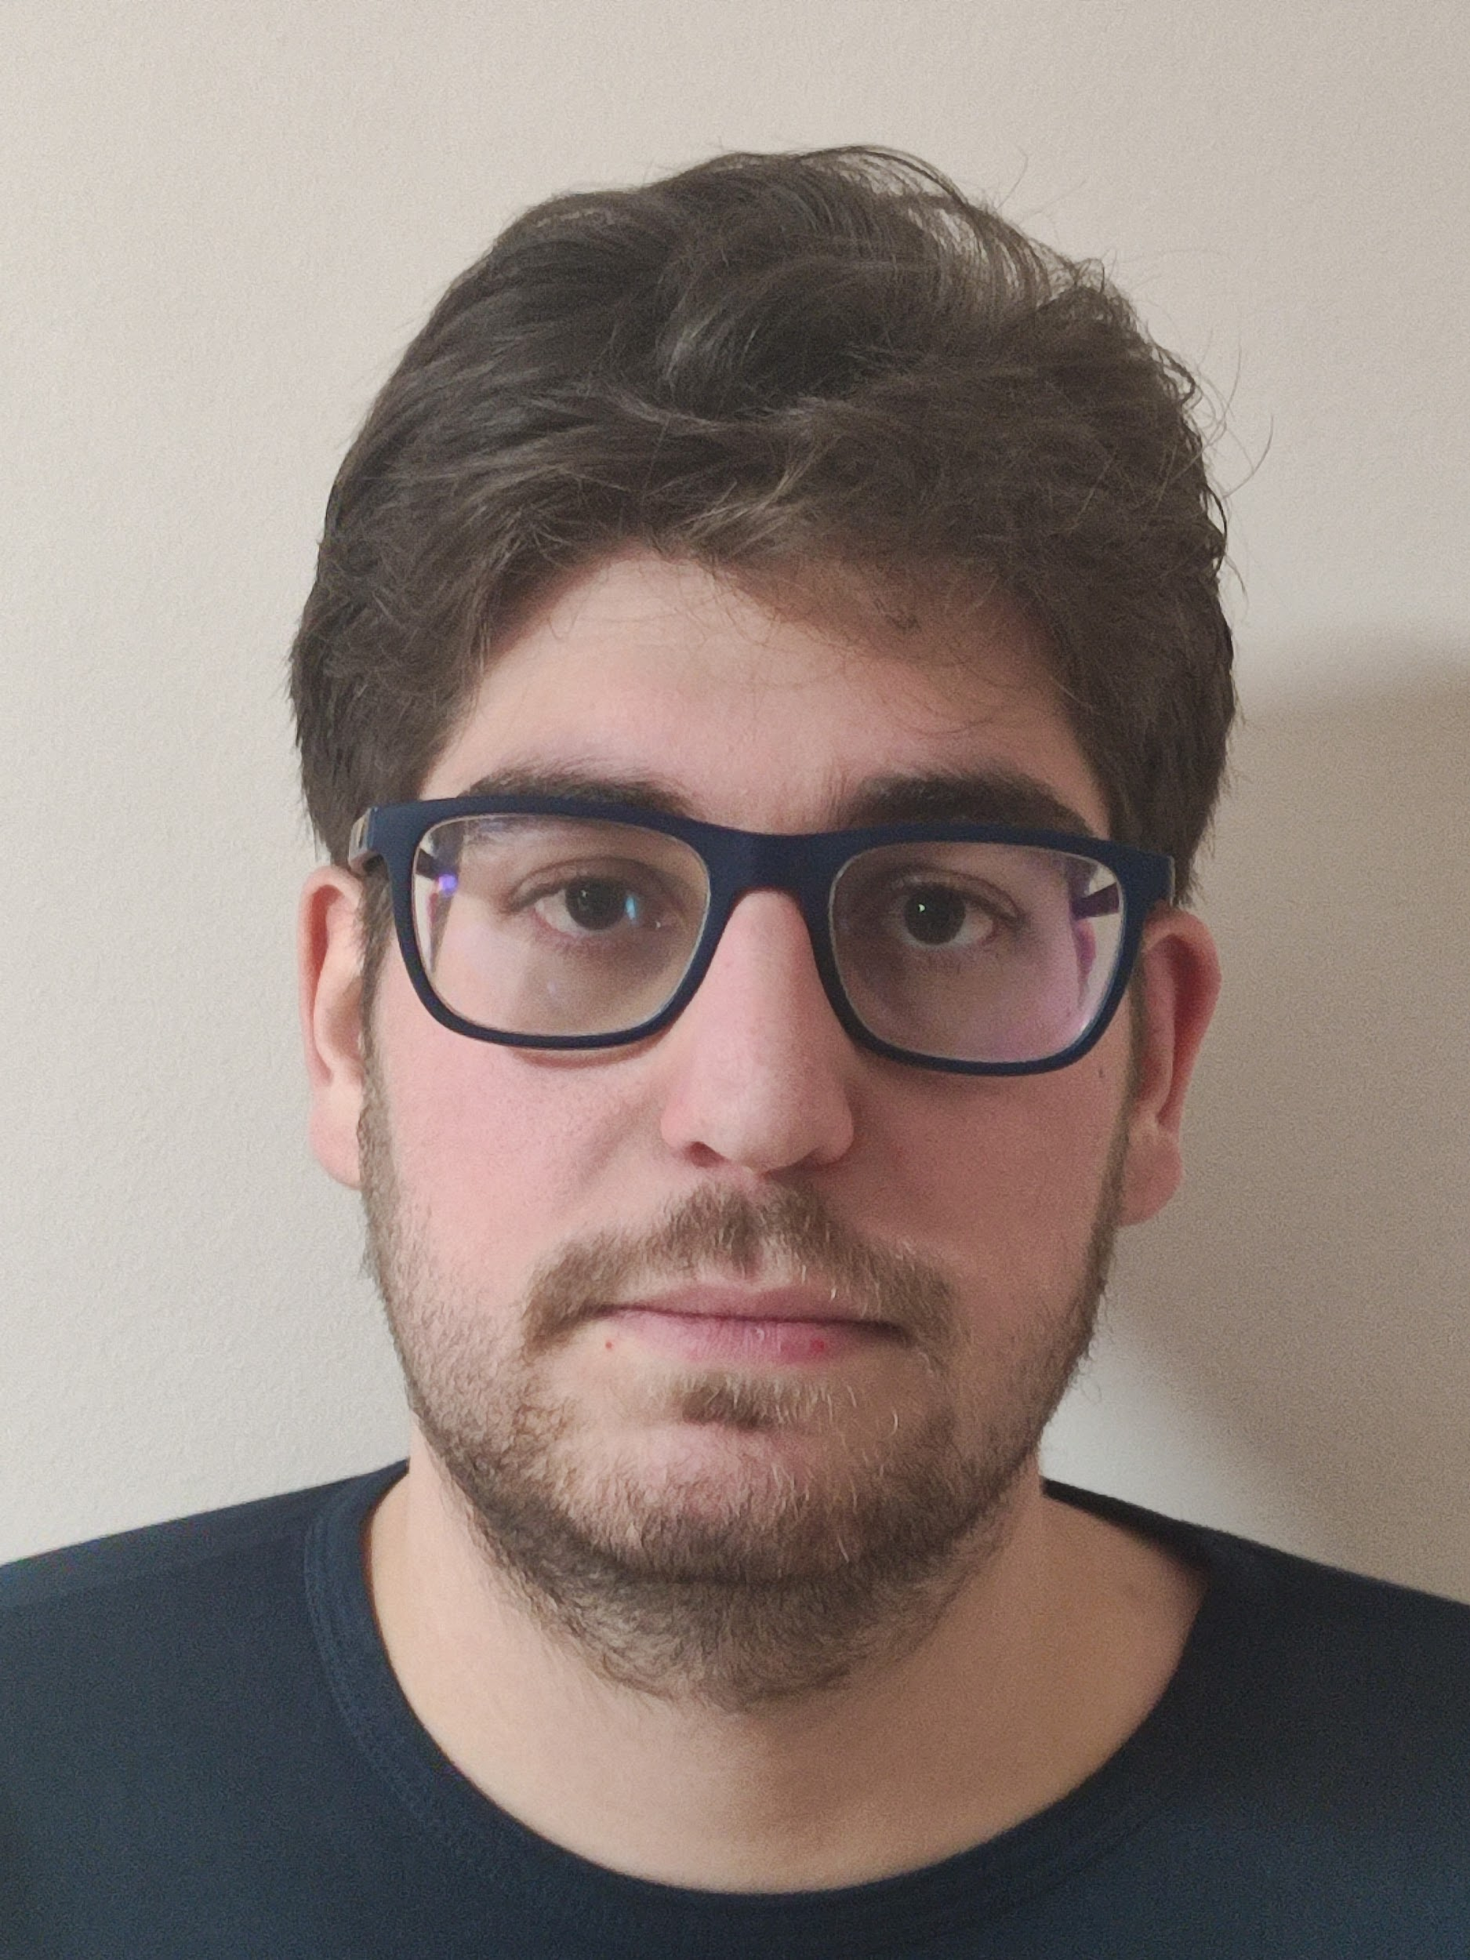
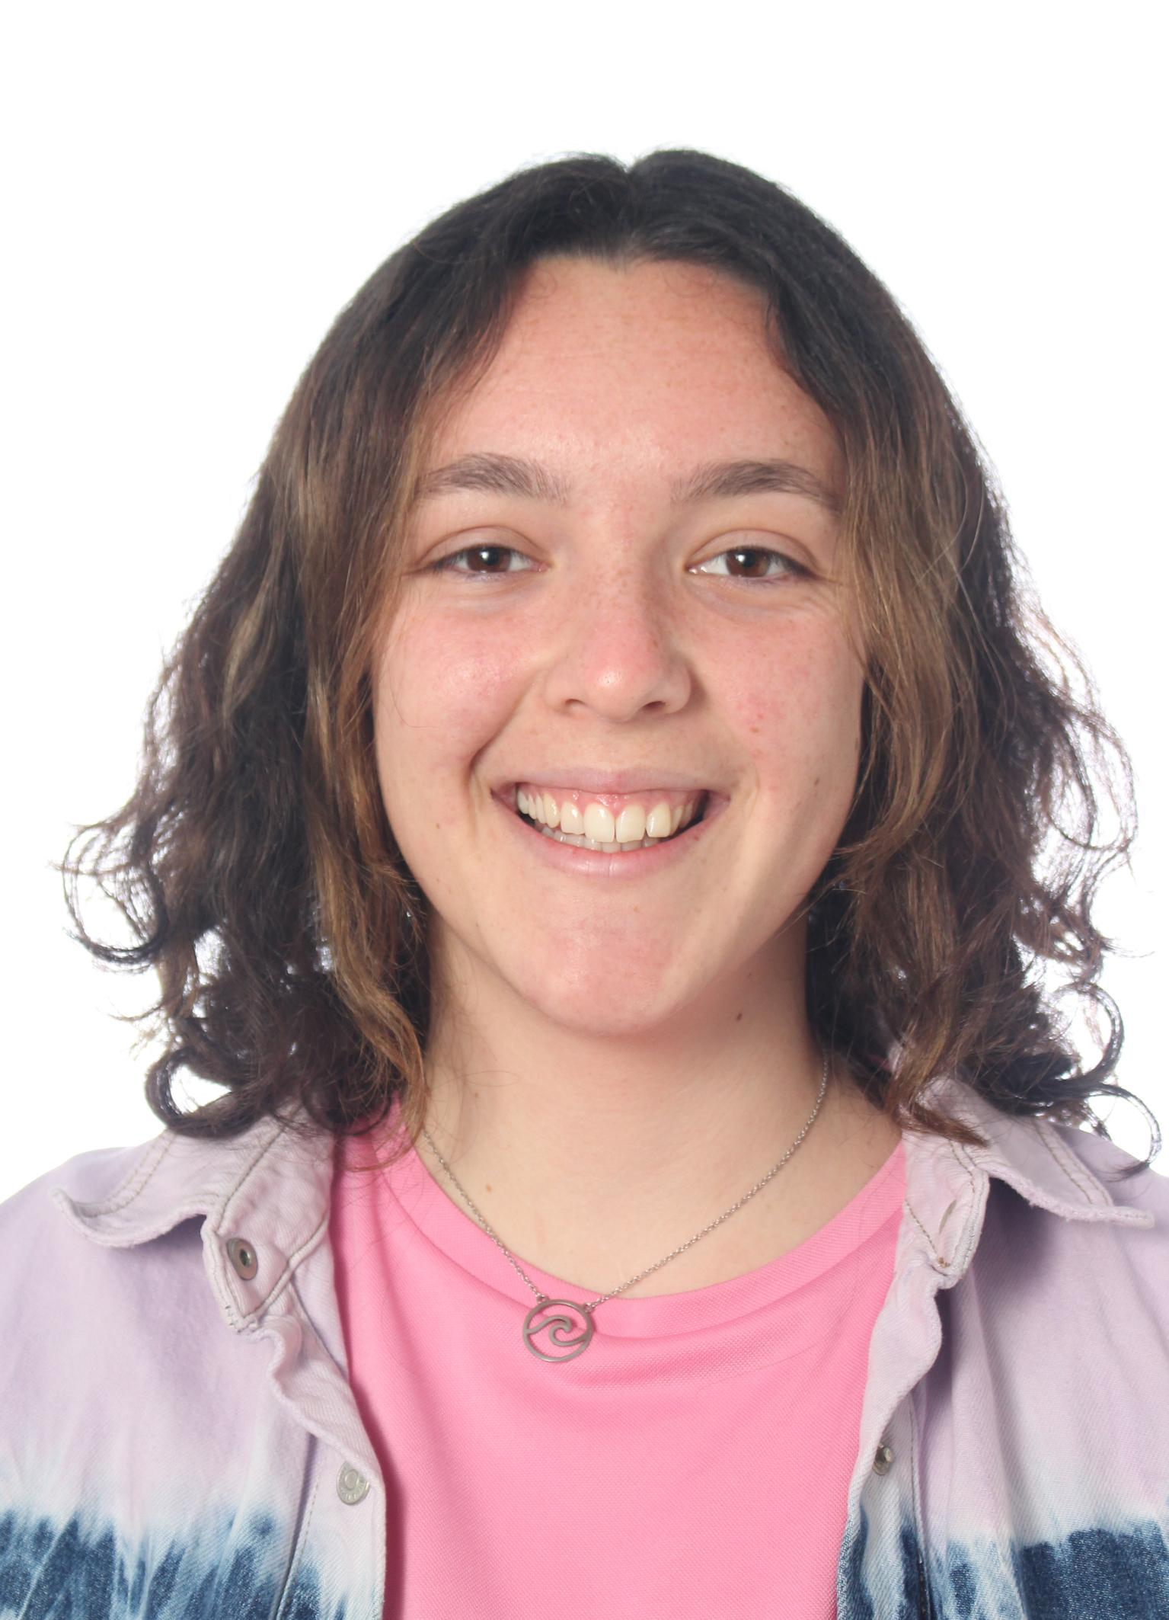
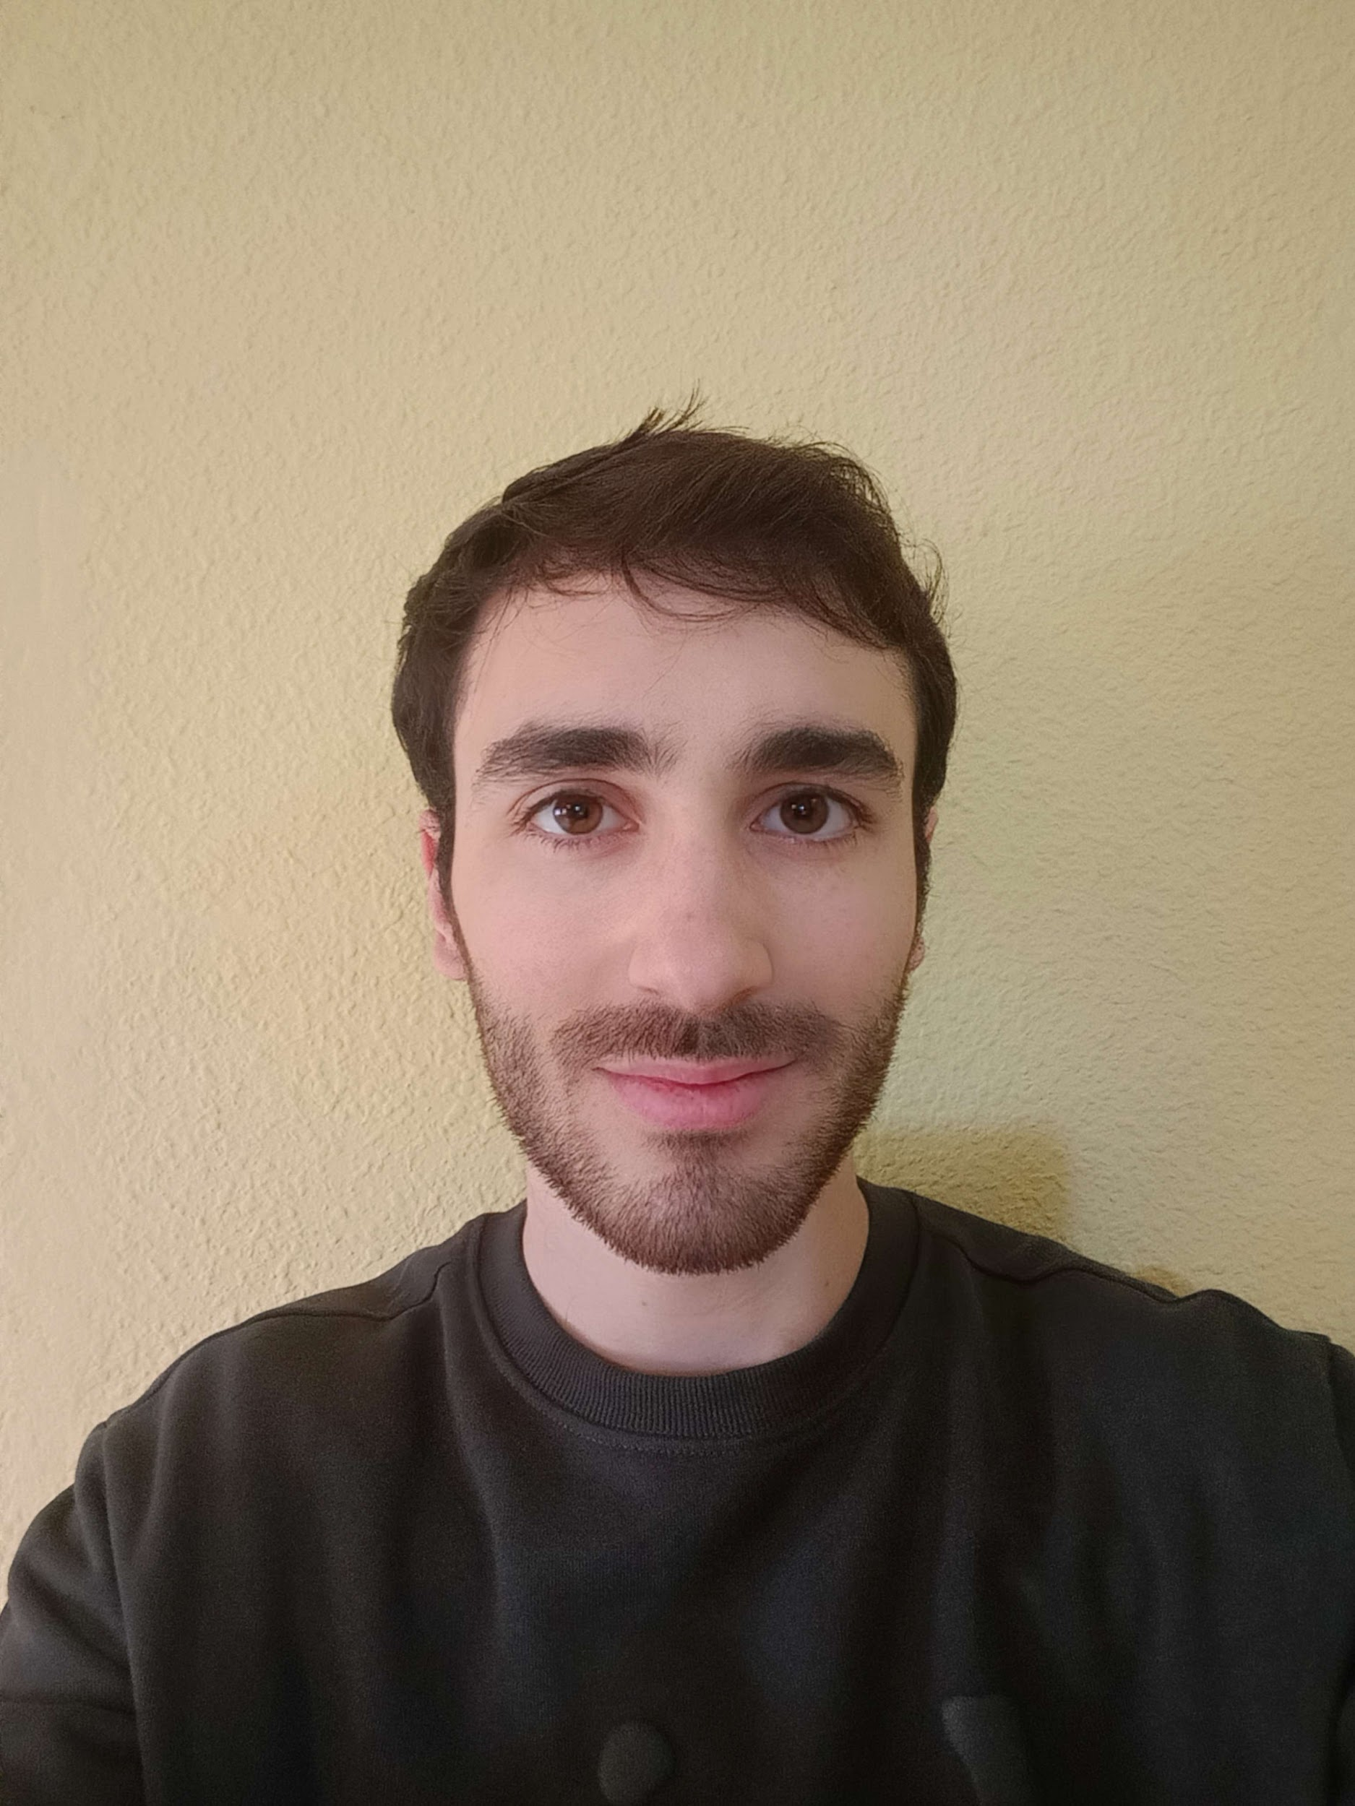
Our team (Back End Programmers)
Felix Gudiel
Juan Luis Ruano
Manuel Ortiz
Community Manager
Pedro López
Aurora Navas
Sergio Aguayo
Miguel Ángel Romalde
Community Manager
Community Manager
Secretary

Slide 4
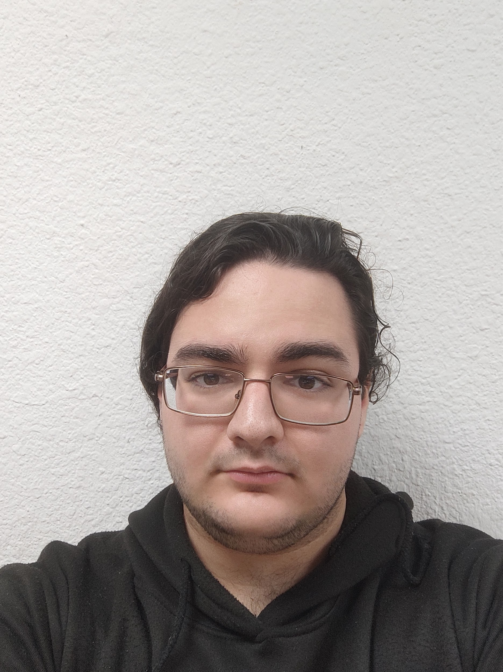
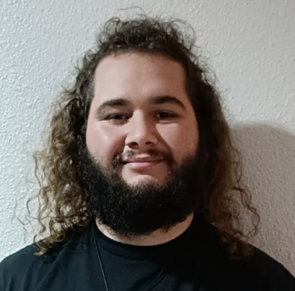
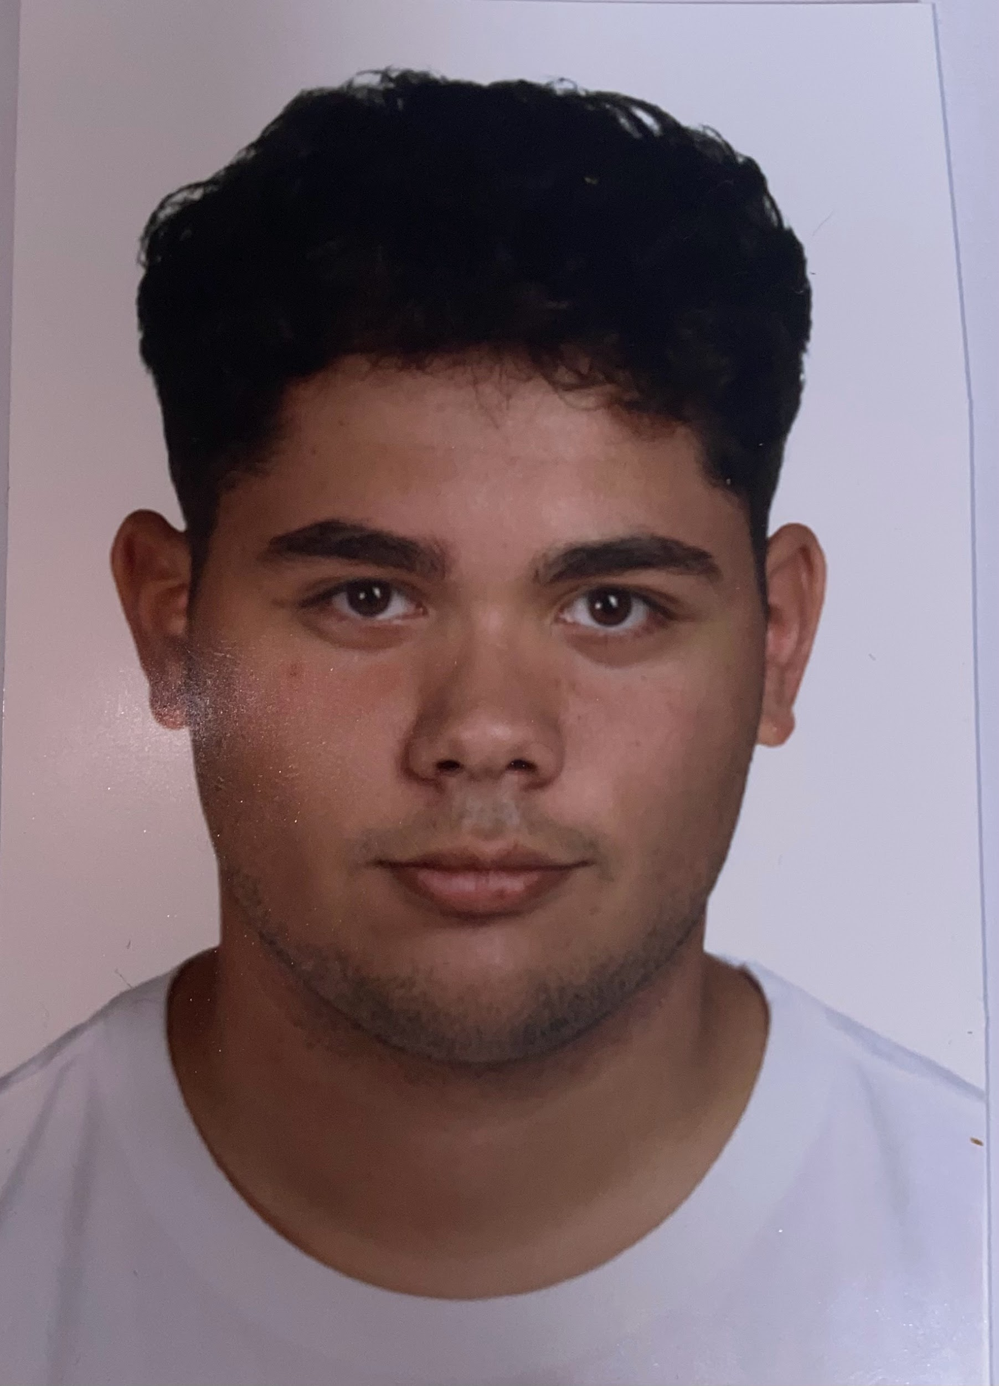
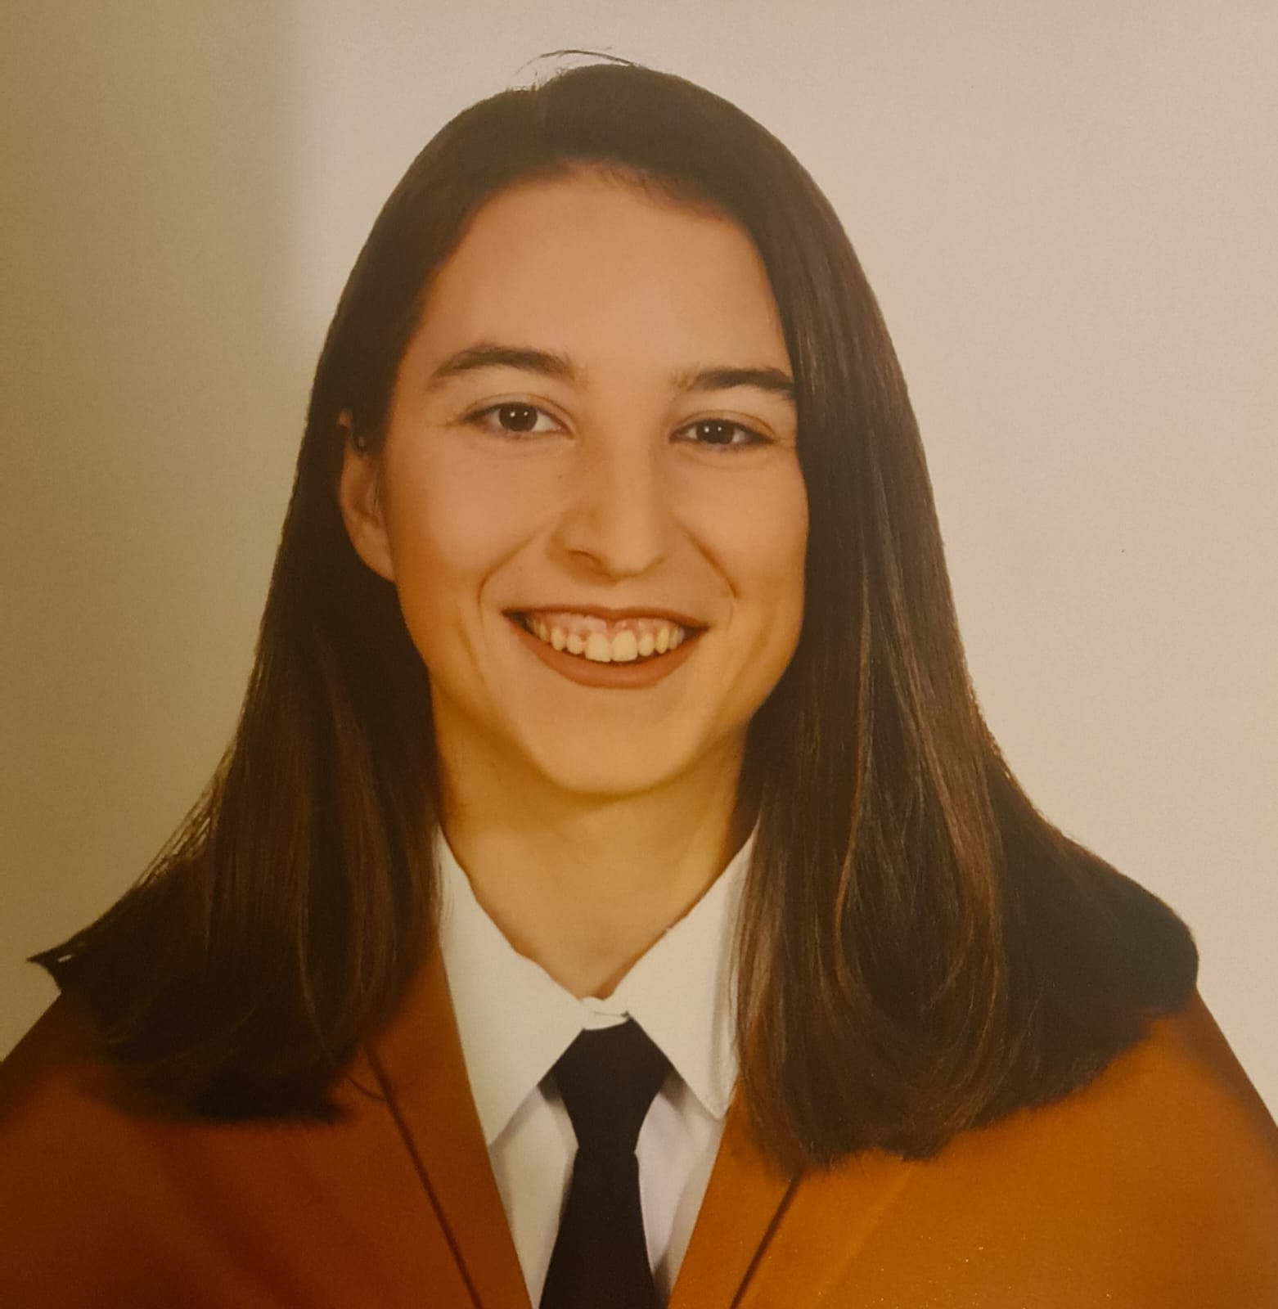
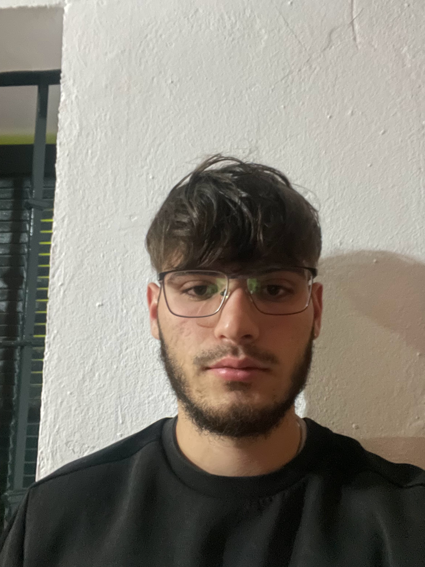
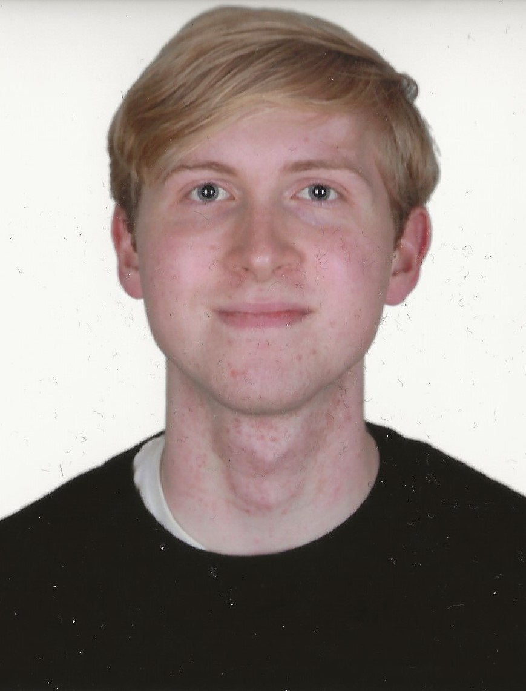
Our team (Front End Programmers)
Francisco Calderón
Francisco Rosso
Manuel Barcia
María Nuñez
Iván Ramírez
Samuel Rodríguez
Marta González

Slide 5

Retrospective (25.02)
Went Well (11) | To Improve (15) | Actions (3)
Fellowship | Task Management | More communication
Individual Performance | Definition of Responsibilities | Assign documents at the beginning of the week
 | Initiative of some members | Better PM management

Slide 6
Retrospective (02.03)
Went Well (9) | To Improve (16) | Actions (4)
Good feedback | GitHub rules | Soften GitHub measures
Taking into account the feedback | Lack of clarity | More descriptive issues
Meeting with the NGO | Leadership | Better PM management
Adaptability | Knowledge of the project | Informative meetings with the order of the day
Protocols and good practices | Actitude

Slide 7
Retrospective (09.03)
Went Well (6) | To Improve (21) | Actions (7)
Made changes | Read the description of the issue | Help more
Talk about the problems going on | Dismiss complaints because they don’t like being called out | Vote on past marks again
Share our opinions and listen to other in the meeting | Work together instead of trying to slit each other’s throats | Reduce scope and give people more time
Discussions | Don’t punish people just because they aren’t your friends | Stop making excuses to stroke your egos
Organization of the tasks | Care more about the project and less about hours and grades and you’ll get good grades | Talk the problems out loud so we can solve them

Slide 8


Problems and Solutions
01
Disagreements
and lack of trust

Slide 9



Problems and Solutions
01
02
Disagreements
and lack of trust
Commits and branches Policies

Slide 10




Problems and Solutions
01
02
03
Disagreements
and luck of trust
Commits and branches Policies
Knowledge about
the project

Slide 11


Problems and Solutions
01
02
03
04
Disagreements
and lack of trust
Commits and branches Policies
Knowledge about
the project
Lack of attention
when reading issues’ description

Slide 12
Problems and Solutions
01
02
03
04
05
Disagreements
and luck of trust
Commits and branches Policies
Knowledge about
the project
Evaluations
Lack of attention
when reading issues’
description

Slide 13
Evaluation Progress
Metrics
Values
Individual Contribution
Collaboration
Quality
Time Management
Clockify / Performance (20%)
1 → 5
2 → 6.5
3 → 7.5
4 → 9
5 → 10

Slide 14
Evaluation Progress
Metrics
Values
Individual Contribution
Collaboration
Time Management
Performance (10%)
1 → 5
2 → 7
3 → 9
4 → 9.5
5 → 10

Slide 15

Performance Progress
Metrics
Task Mark (CR)
Time Spent (TI)
ToDo Tasks (TNR)
Perf=CR - TI*0.1 - TNR*0.25

Slide 16

Performance Progress
Metrics
Task Mark (C) = Quality
Effort (E) = Clockify + Poker Planning
ToDo Tasks (TNR)
Perf= C * (E - TNR)

Slide 17
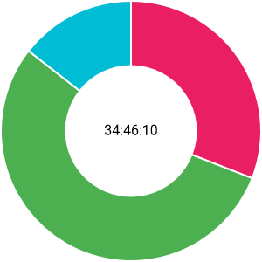
Individual Performance
Team Organization
Mockups
Presentations
Meeting with the NGO
Marta González

Slide 18
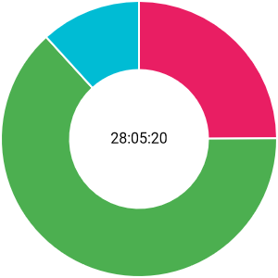
Individual Performance
Marta González
Retrospective
W4 and W5 presentation
Modification of requirements
App styles
Exporting Mock-ups
Information required by the NGO
Meeting with the NGO
Homepage Transparency Screen
GitHub Actions
Lessons Learnt

Slide 19
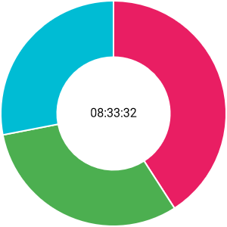
Individual Performance
Marta González
Presentation
Retrospective
System Evaluation
PM Responsibilities

Slide 20

Individual Performance
Marta González
 | Sistema 1 | Sistema 2
DP | 10 | 10
S1 | 10 | 10,4
Variance

Slide 21
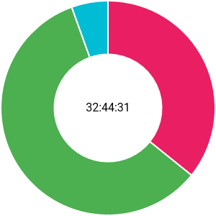
Individual Performance
Creating, organizing, and maintaining GitHub
Commitment agreement
Risk analysis
Manos abiertas Meeting
NGO Requirements Document
Rubric system and form
Individual performance documentation
User Screens in Mockup and Prototype
Group Knowledge Database
Pablo Periañez

Slide 22
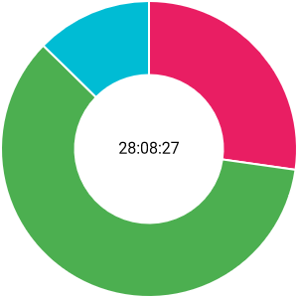
Individual Performance
Pablo Periañez
Lead the backend team
Agreement Appendix
Performance Measures
S1 Self-Assessment/Rubric
Switching from DB to PostgreSQL
Relational model
S2 Planning
Student CRUD and Exit Authorizations
Meeting with the NGO

Slide 23
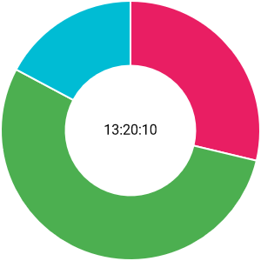
Individual Performance
Pablo Periañez
Lead the backend team
System Evaluation
S2 Planning
Poker Planning

Slide 24

Individual Performance
Pablo Periañez
 | System 1 | System 2
DP | 10 | 10
S1 | 9.8 | 10.3
Variance

Slide 25
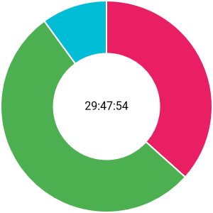
Individual Performance
SWOT NGOs
Mockups
MVP
Planning sprints (frontend)
Claudia Gilabert

Slide 26
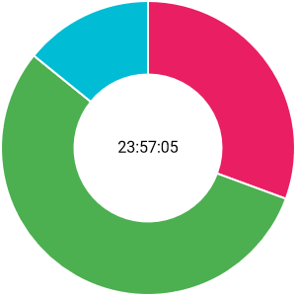
Individual Performance
Claudia Gilabert
Lead the frontend team
Home Page
Deployment
Connecting to the backend
Meeting with the NGO
S2 Planning

Slide 27
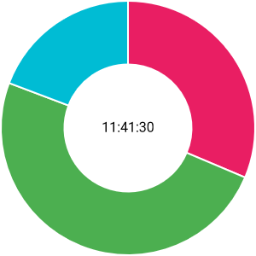
Individual Performance
Claudia Gilabert
Lead the frontend team
S2 Planning
Login
Favicon change
Educators Component

Slide 28
Individual Performance
Claudia Gilabert
 | System 1 | System 2
DP | 9.8 | 9.9
S1 | 9 | 9.7
Variance

Slide 29
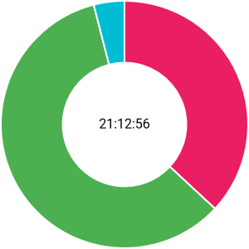
Individual Performance
Uses of AI
Preliminary Competitor Analysis
Use of the Theoretical Pill
Felix Gudiel

Slide 30
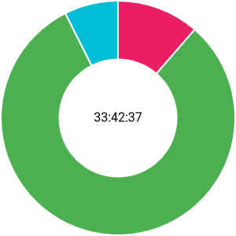
Individual Performance
Felix Gudiel
Problems that happened during S1
AI carryovers
Populate
Upload documents to the DB

Slide 31
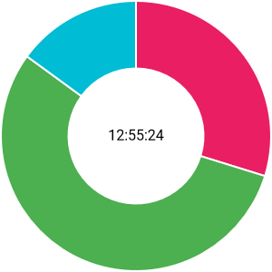
Individual Performance
Felix Gudiel
IA Report
Check Business Logic

Slide 32
Individual Performance
Felix Gudiel
 | System 1 | System 2
DP | 8.8 | 9.3
S1 | 9.5 | 10.1
Variance

Slide 33
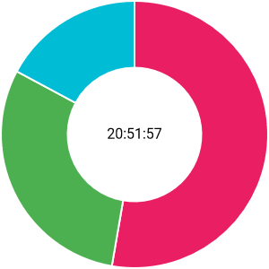
Individual Performance
Degree of technological innovation
Landing page
Juan Luis Ruano

Slide 34
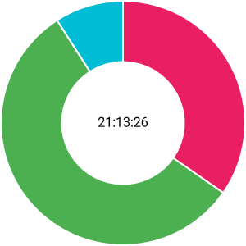
Individual Performance
Juan Luis Ruano
Revenue Estimates
Populate
DB Schema
User Roles
Evaluation CRUD

Slide 35
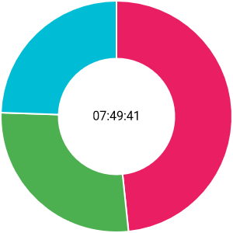
Individual Performance
Juan Luis Ruano
Remove admin authentication

Slide 36
Individual Performance
Juan Luis Ruano
 | System 1 | System 2
DP | 8.8 | 9.3
S1 | 9.3 | 9.9
Variance

Slide 37
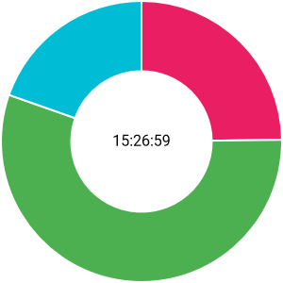
Individual Performance
Communication agreement
Quality & Improvement
Manuel Ortiz

Slide 38
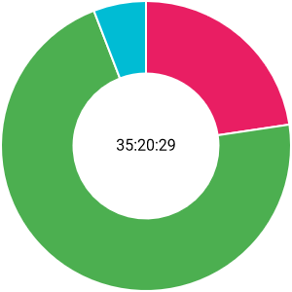
Individual Performance
Manuel Ortiz
Cost analysis
Architecture
DB Schema
CRUD of Users, Educators, Partners, Volunteers and Families

Slide 39
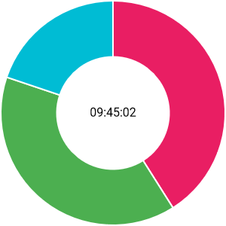
Individual Performance
Manuel Ortiz
Poker planning

Slide 40
Individual Performance
Manuel Ortiz
 | System 1 | System 2
DP | 8.0 | 8.5
S1 | 8.9 | 9.7
Variance

Slide 41
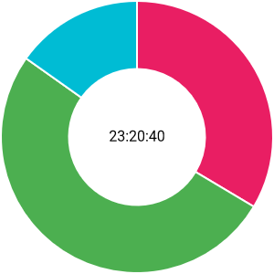
Individual Performance
Define Client User Roles
Complement AI Document
Get in touch with padel integra
Define quality and improvement
Pedro López

Slide 42
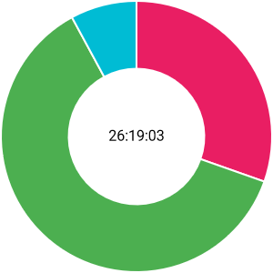
Individual Performance
Pedro López
Architecture
Implementing the DB Model
CRUD of Classes

Slide 43
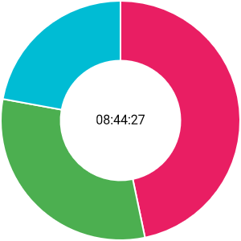
Individual Performance
Pedro López
Lecciones Aprendidas
Matriz RACI

Slide 44
Individual Performance
Pedro López
 | System 1 | System 2
DP | 9.3 | 9.6
S1 | 9.2 | 9.5
Variance

Slide 45
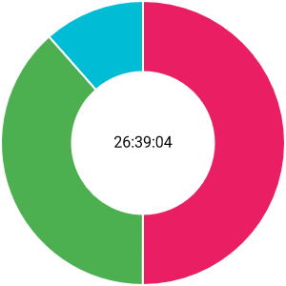
Individual Performance
SWOT NGOs
Risk analysis.
Help with the creation of the presentation.
Contact with Manos abiertas
Aurora Navas

Slide 46
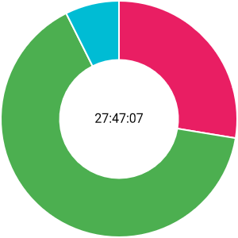
Individual Performance
Aurora Navas
Pilot User Management
Governify
DB Schema
DB Model
Deployment

Slide 47
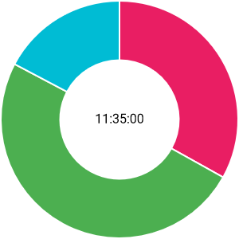
Individual Performance
Aurora Navas
Documentation as Code

Slide 48
Individual Performance
Aurora Navas
 | System 1 | System 2
DP | 9.5 | 9.7
S1 | 9.7 | 10.2
Variance

Slide 49
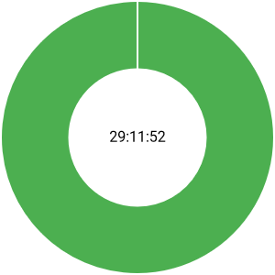
Individual Performance
First MVP Sketch
Innovation & Technology
Methodological aspect of development and doc contribution to the class common knowledge base
Management of the Common Knowledge Database
Sergio Aguayo

Slide 50
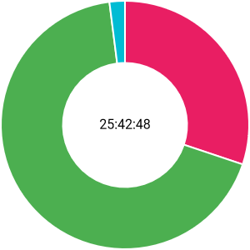
Individual Performance
Sergio Aguayo
Event CRUD
Assembly CRUD
Model Planning
CRUD Donations
Revisit Event CRUD and Create Excursion CRUD
Common Knowledge DB

Slide 51
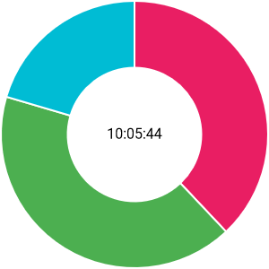
Individual Performance
Sergio Aguayo
Common Knowledge DB

Slide 52
Individual Performance
Sergio Aguayo
 | System 1 | System 2
DP | 9.7 | 9.8
S1 | 9.5 | 10.1
Variance

Slide 53
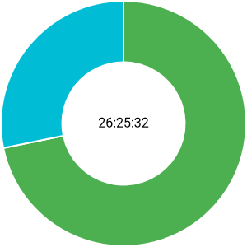
Individual Performance
Cost Analysis Document
Mockup Help
Planning Sprints (Backend)
Reorganization to meet failure conditions
Miguel Ángel Romalde

Slide 54
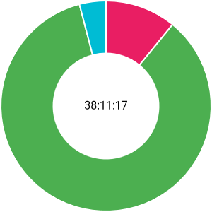
Individual Performance
Miguel Ángel Romalde
Cost analysis
TCO: Capex, Opex
Relational model
CRUD of Users, Educators, Partners, Volunteers and Families

Slide 55
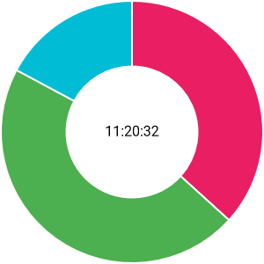
Individual Performance
Miguel Ángel Romalde

Slide 56
Individual Performance
Miguel Ángel Romalde
 | System 1 | System 2
DP | 9.1 | 9.3
S1 | 7.9 | 8.7
Variance

Slide 57
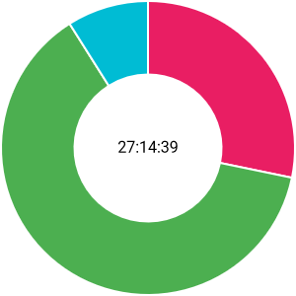
Individual Performance
Competitor Analysis
Versioning Policy
Refine key business ideas
Identify the customer
Identify the type of business
Francisco Calderón

Slide 58
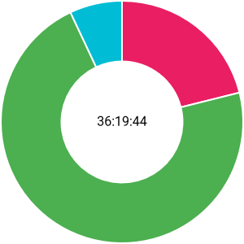
Individual Performance
Francisco Calderón
Landing page
Partner Management Screen
Account Management Screen

Slide 59
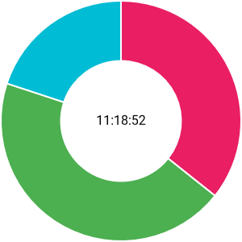
Individual Performance
Francisco Calderón
Admin Profile

Slide 60
Individual Performance
Francisco Calderón
 | System 1 | System 2
DP | 9.4 | 9.7
S1 | 8 | 8.9
Variance

Slide 61
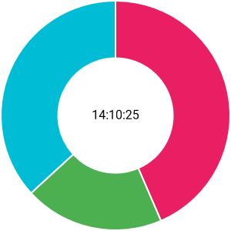
Individual Performance
Meeting with the NGO
Francisco
Rosso

Slide 62

Individual Performance
Francisco
Rosso
NavBar Activities
Login in NavBar
NavBar Class

Slide 63

Individual Performance
Francisco
Rosso
NavBar Suggestions

Slide 64
Individual Performance
Francisco
Rosso
 | System 1 | System 2
DP | 7 | 7.8
S1 | 8.1 | 9.2
Variance

Slide 65

Individual Performance
Who is a user and who is a customer?
Charter go
Improve Team Organization
Performance measurement of each member on the team
Manuel
Barcía

Slide 66

Individual Performance
Manuel
Barcía
Dropdown of the Homepage about the Association
Class, Event, and Project Manager screen
Cost analysis
Architecture

Slide 67

Individual Performance
Manuel
Barcía
Volunteers Agenda
Volunteers Component

Slide 68
Individual Performance
Manuel
Barcía
 | System 1 | System 2
DP | 9.3 | 9.6
S1 | 9.2 | 9.9
Variance

Slide 69

Individual Performance
Pilot Users
Creating the Presentation
Mockups
María Nuñez

Slide 70

Individual Performance
María Nuñez
Governify
Family Management
Agenda 2030

Slide 71

Individual Performance
María Nuñez
Styles
Documentation as code

Slide 72
Individual Performance
María Nuñez
 | System 1 | System 2
DP | 10 | 10
S1 | 9.3 | 9.8
Variance

Slide 73

Individual Performance
Cover Template
Competitor Analysis
Versioning Policy
Refine key business ideas.
Feedback general
Identify the customer.
Identify the type of business.
Iván Ramírez

Slide 74

Individual Performance
Iván Ramírez
Partner Management Screen
Account Management Screen
Partnership Dropdown

Slide 75

Individual Performance
Iván Ramírez
Admin Volunteers and Educators

Slide 76
Individual Performance
Iván Ramírez
 | System 1 | System 2
DP | 8.9 | 9.4
S1 | 7.3 | 8.3
Variance

Slide 77

Individual Performance
Competitor Analysis
Degree of Innovation and Technology required
Samuel Rodríguez

Slide 78

Individual Performance
Samuel Rodríguez
Form Screen
Registration in the NavBar

Slide 79

Individual Performance
Samuel Rodríguez
Problems
Admin classes, projects and events

Slide 80
Individual Performance
Samuel Rodríguez
 | System 1 | System 2
DP | 9.3 | 9.6
S1 | 9.2 | 9.9
Variance

Slide 81


Time Used (up to Sunday 10th 15:30)
At home (64%)
Meetings (11%)
Lessons (25%)

Slide 82

Time Used (up to Sunday 10th 15:30)
48.1% (1.155 hours)
Time Used
51.9% (1.245 hours)
Time Left

Slide 83
Commitment agreement
Time Dedication
100 %
Rewards
Weekly Effort
100 %
Review
Deadlines
66.6 %
Disagreements
Strikes
Democracy
Clockify
Evaluation
Appendix

Slide 84
Thanks for your time!

